Slide 1

BUS7C3 International Organisational Branding
Lecture 4 - Employer Branding as a Corporate Reputation Management Tool

Slide 2

Week 3 Recap
Organisations needs to differentiate its employment offering from those “appreciated” by employees at various other organisations.
The presentation of what the reward package or employee benefit features/advantages offered goes some way to evidencing/embedding/underpinning organisational values, characteristics and attitudes, which helps to clarify the employer brand value proposition.

Slide 3
This week’s learning outcomes
At the end of this session, you will be able to:
Analyse and compare different theoretical models.
Synthesise the theoretical position of employer branding.
Evaluate employee-based brand equity in the context of employer organisational branding.
Apply the above to your assignment in the form of critical discussion.

Slide 4
Theoretical Position of Employer Branding
When reviewing the literature associated with employer branding, it is apparent that the concept involves a very obvious mix or coming together of the fields of marketing and HR (Edwards, 2010).
Employer Branding will involve identifying the unique “employment experience” by considering the totality of tangible and intangible reward features that a particular organisation offers to its employees (Edwards, 2010).
A “company’s image as seen through the eyes of its associates and potential hires” (Martin and Beaumont, 2003).

Slide 5
Theoretical Position of Employer Branding
Do positive perceptions of an organisation’s reputation make an organisation more attractive?
Employer branding strategies very often include communication factors to increase people’s understanding and awareness of the organisation’s reputation, any information that demonstrates company successes would expect to have a positive impact.

Slide 6
Theoretical Position of Employer Branding
Studies by Turban and Greening (1996) that has considerable relevance to employer branding programmes is the finding that when organisations were rated higher on a full range of socially responsible features (community and employee relations, environmental policies, product quality and treatment of minority groups).

Slide 7
Theoretical Position of Employer Branding
Cable and Turban (2003) completed studies which showed the importance of company reputation in increasing the likelihood of potential applicants applying for a job at the organisation.
Results from those studies suggested that job seekers’ reputation perceptions affected job pursuit because (a) individuals use reputation as a signal about job attributes, and (b) reputation affects the pride that individuals expect from organisational membership (Cable and Turban, 2003).

Slide 8
Employee-based Brand Equity/Internal Employer Branding
Commonly defined:
Employee-based Brand Equity (EBE) is described as a “set of employment brand assets and liabilities linked to an employment brand, its name and symbol that add to the value provided by an organisation to that organisations employees”, (Ewing, et al 2002).
Internal Employer Branding - Not to be confused with internal branding.
Retention: Internal employer branding - branding focusing on retaining current employees as a target group.

Slide 9
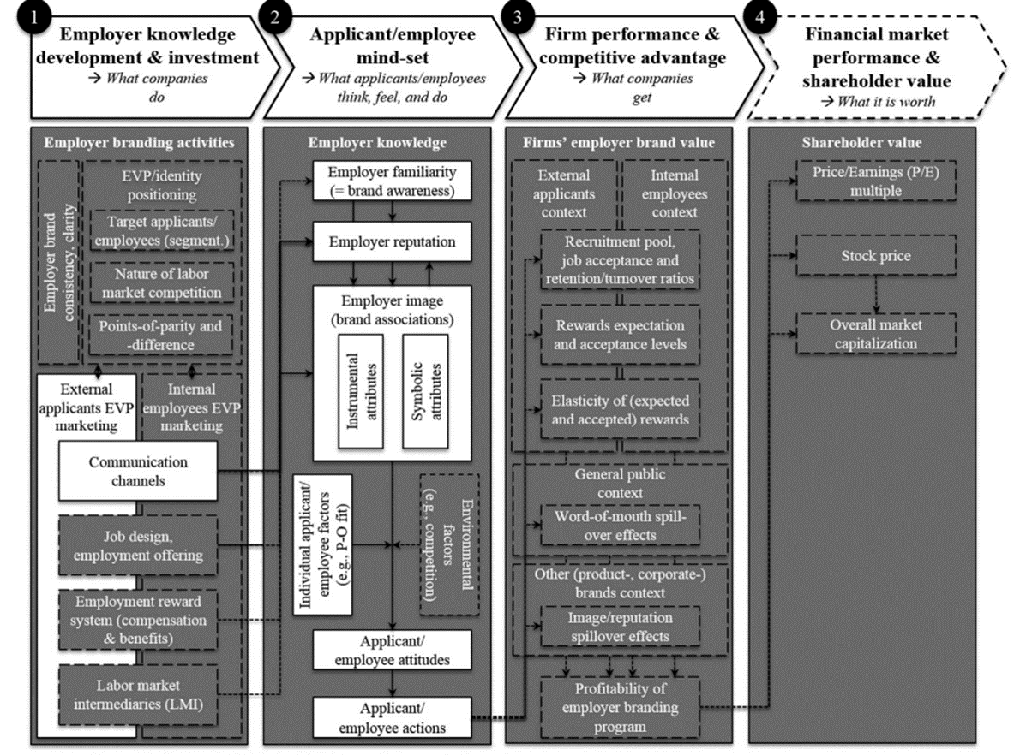
Employer Branding Value Chain Model

Slide 10
Employer Branding Value Chain Model
What organisations can do (tangible). What organisations can do to develop the key message of the brand (employer value proposition – week 5 studies).
What employees think and feel (intangible). Interactions with employee branding and employee (and potential employee) mindsets.
What organisations achieve/gain/get (tangible). Organisational performance and competitive advantage, and its influence on employees and potential employees. Reliant on employer knowledge and job pursuit. Candidates may accept a lower salary to work for a reputational organisation.
Monetary value of that employer branding (tangible). Financial market performance and shareholder value. Market capitalisation.

Slide 11
Human Resources/Management Perspective
By highlighting effective levers, interrelations and outcomes in the field, firms gain a clearer picture of effective employer brand management. Management can thereby attain and steer relevant recruitment and retention policies, and consider spillover effects more ultimately to make a positive contribution to their organization’s (financial) performance (Theurer et al, 2018).

Slide 12
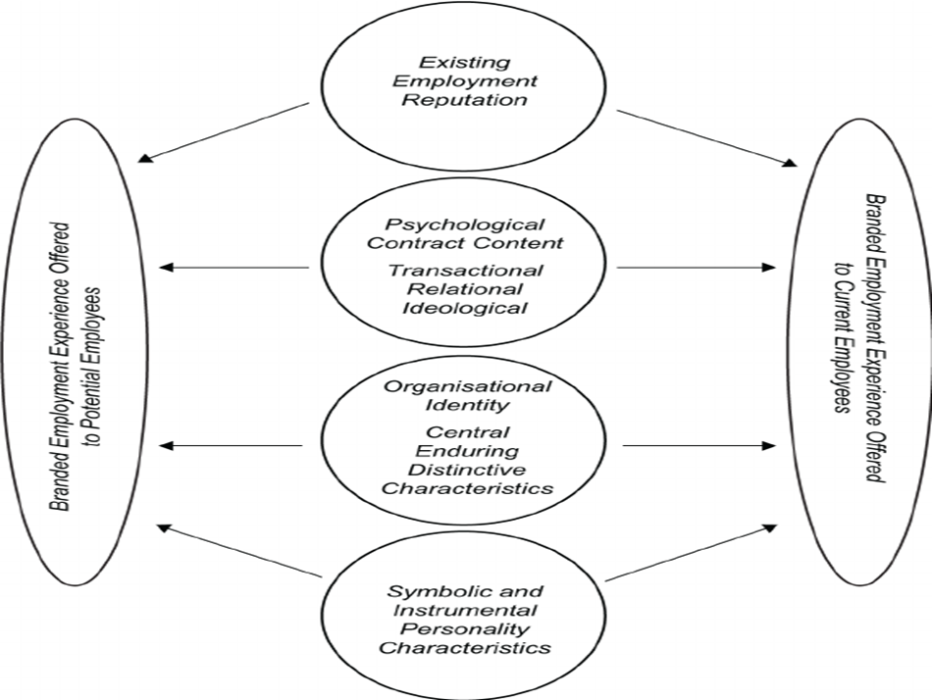
Employer Branding Model
An integrative review of employer branding and organizational branding theory: “HR, perceived organisational support and organisational identification: an analysis after organisational formation”,

Slide 13
VLOG
Considering today’s lecture, think about the impact of theoretical models and concepts which have and affect on your VLOG, how you will apply them, and how they contrast to research you have already undertaken.
Please remember to take notes – these will be invaluable to you when you complete your portfolio report.

Slide 14

Thank you!
Any questions?

